Slide 1
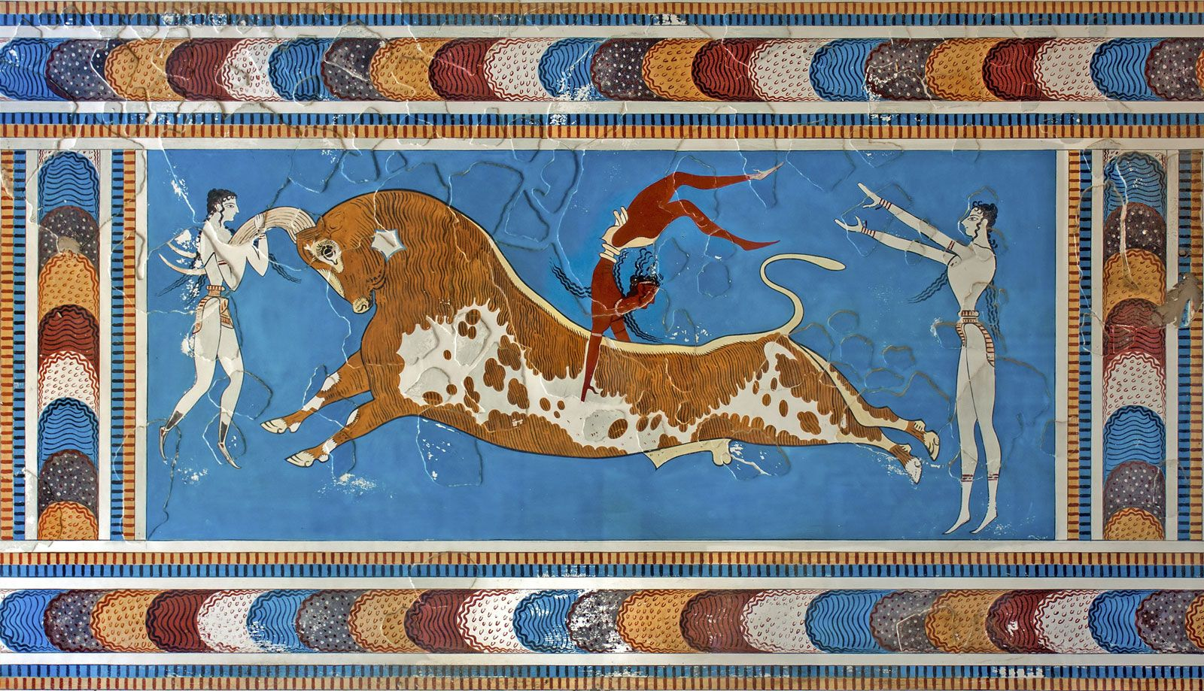
Minoans - Religion
Goal/s:
Identify and describe the key features of the Minoan Religion/mythology
Week 2 Lesson 2
Ms Barrie

Slide 2
Mini Whiteboards – Review Quiz
Get ONE (1) whiteboard between two
Answer the following questions about the Minoans on the whiteboards
HOVER IT
CHIN IT
PARK IT

Slide 3
1. What are the dates of the Minoan civilization?
1500 BCE to 500 BCE
2000 BCE to 1000 BCE
2100 BCE to 1100BCE
1000 BCE to 2000 BCE

Slide 4
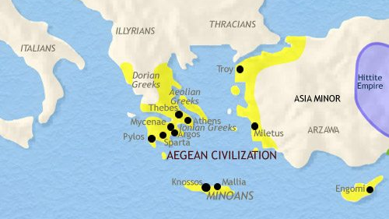
2. Where was they located? (What island?)

Slide 5
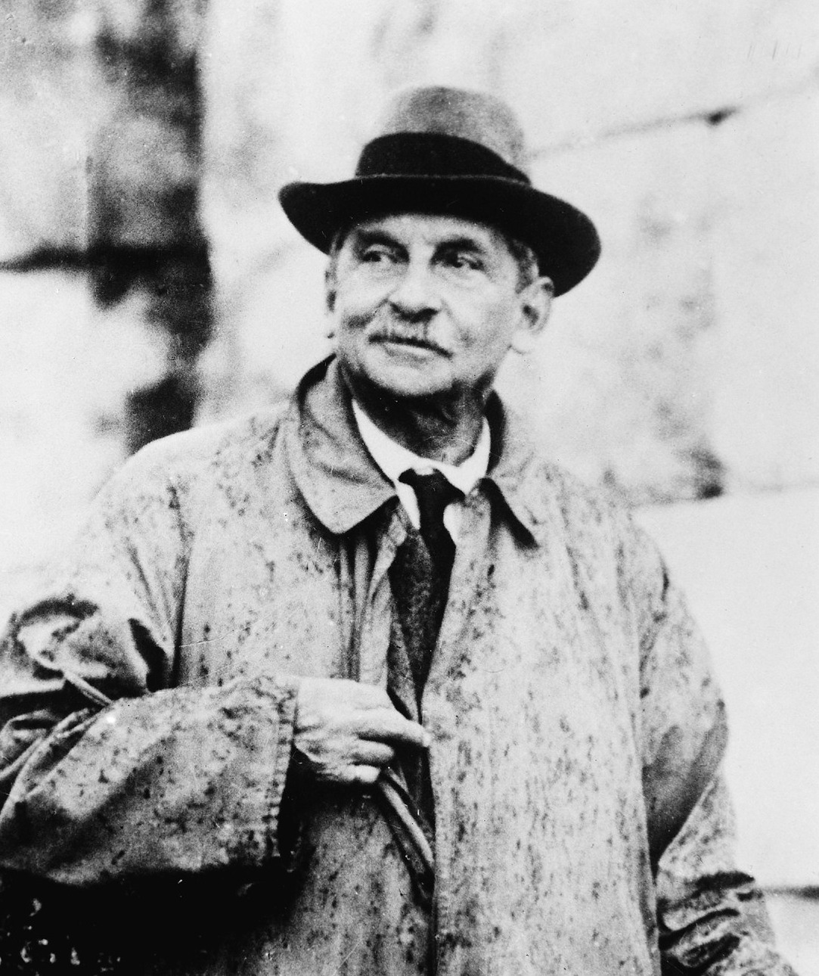
3. Who discovered the Minoan Civilization?

Slide 6
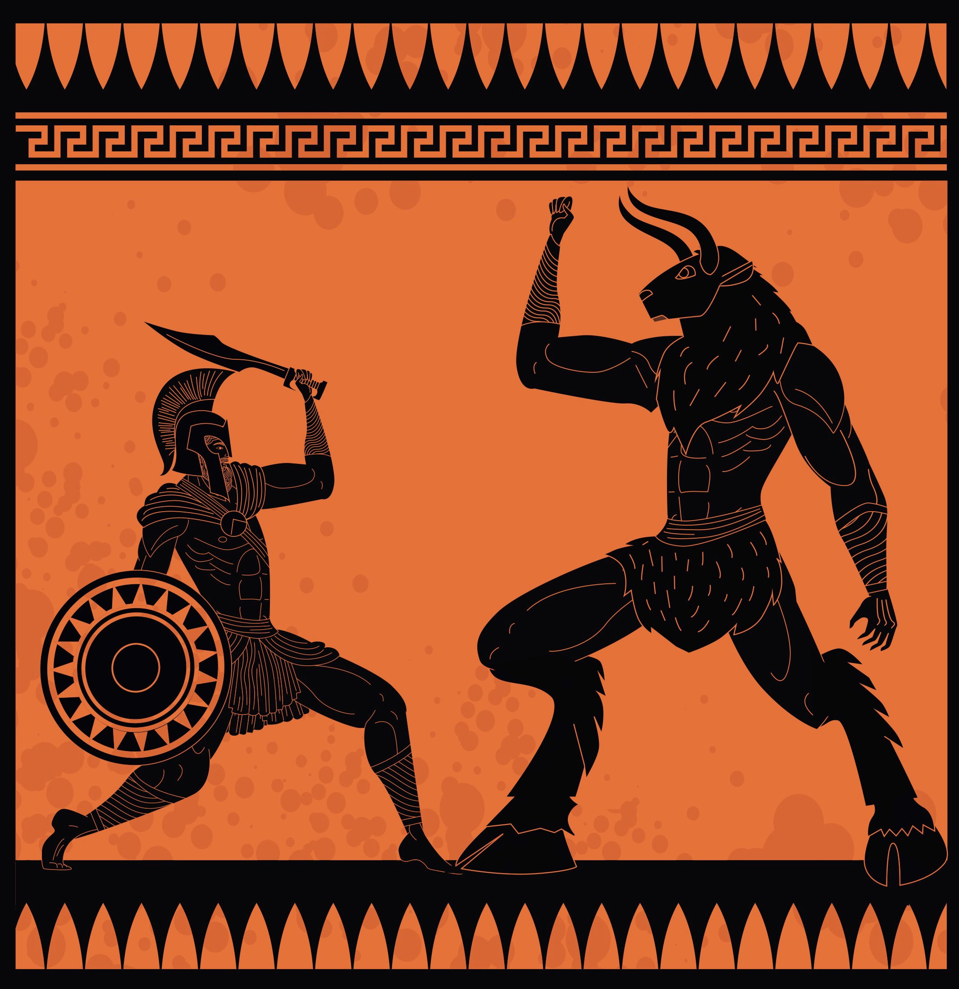
4. What myth are they known for?

Slide 7
Today’s Lesson
Pack up Whiteboards/Markers
Minoan Religion/Mythology

Slide 8
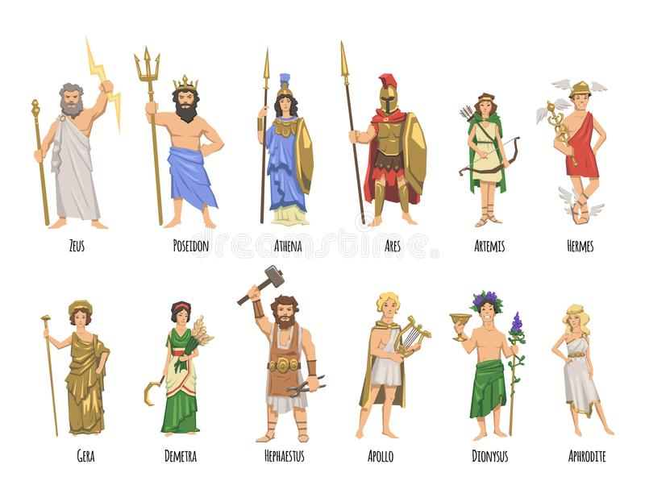
Mythology
KEY TERM
DEFINITION:
a collection of myths, especially one belonging to a particular religious or cultural tradition.
SYNONYMS: belief, legend, religion, tradition, lore

Slide 9
Polytheistic
KEY TERM
DEFINITION:
belief in or worship of more than one god.
ANTONYMS: Monotheistic

Slide 10
Pantheon
KEY TERM
DEFINITION:
all the gods of a people or religion collectively.
Collective noun for group of gods.
SYNONYMS:

Slide 11
The lack of written sources and the fragmentary nature of archaeological evidence makes it difficult to really understand the. Minoans religious beliefs.

Slide 12
Minoan Religion
Worshiped a pantheon: A great goddess, daughter goddess, a male deity represented by a bull
NATURE FOCUS:
‘Snake’, ‘tree’, ‘animal’
Focus on fertility, up-raised arms as a sign of form of blessing/ritual

Slide 13
Key Symbols:
Create a Mind-Map of the following:
Double Axe - Labrys
Bull and Horns of Consecration
Snakes
Pillars/columns
Sacral Knots
Notes:
Consecration: the action of making or declaring something, typically a church, sacred.

Slide 15
TEACHER ONLY INFO:
For mindmap

Slide 16
1. Double Axe - Labrys
Associated with sacrifice of bull
Painted above a bull’s head
Made in all sizes/materials
Painted on art/pottery
Mounted on holders in special places
Powerful deities

Slide 17
2. Bull and horns of consecration
Bull - minotaur, strength
Bull-leaping and wrestling
Stone and plaster horns of consecration - represent horns of bulls
Found at Knossos
Marked sacred spaces

Slide 18
3. Snakes
Symbol of underworld deities
Shed/regrew skin = symbol of renewal/fertility
Goddesses seen with snakes on arms and bodies

Slide 19
4. Pillars/Columns
Inanimate object: incarnations of deity
Represented trees
Found in palaces
Represented Caves - the original labyrinths

Slide 20
5. Sacral Knots
Striped and fringed cloth knotted in a loop in the middle
Worn by a priestess

Slide 21
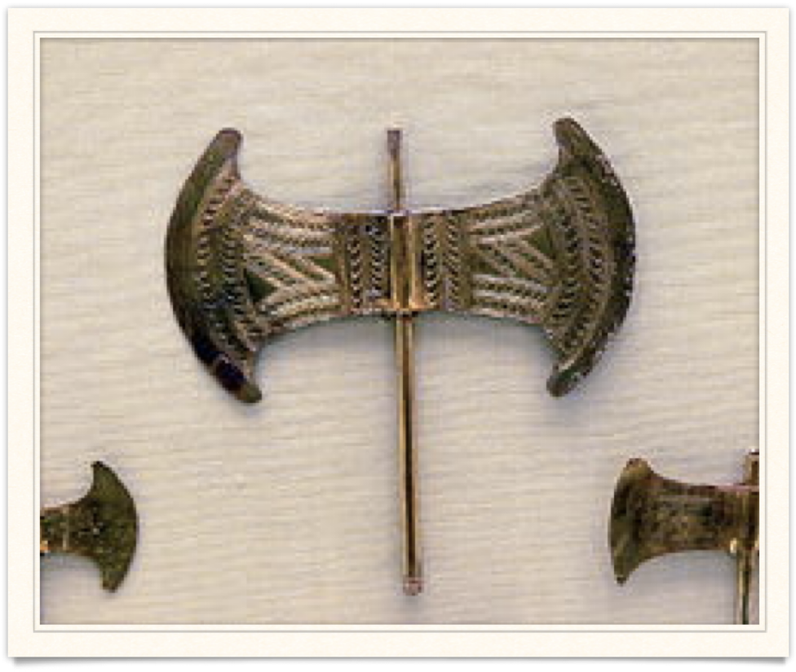

1. Double Axe - Labrys
An ornamented golden Minoan double axe

Slide 22
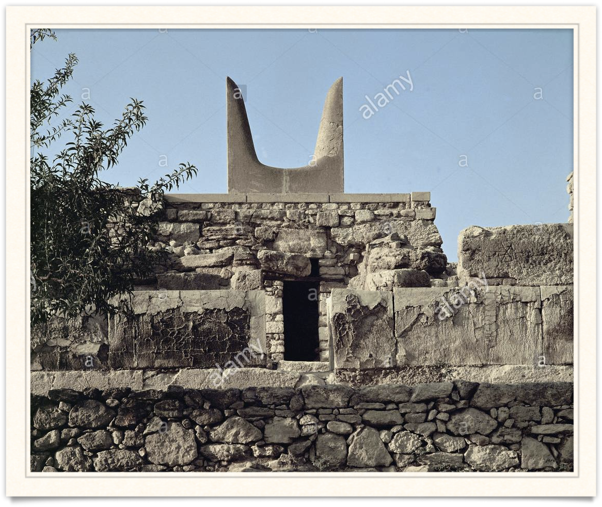
2. Bull and horns of consecration
The bull's horns (" Horns of Consecration") of the Palace of Knossos, Crete. Location: Archaeological Site, Knossos, Crete, Greece.

Slide 23
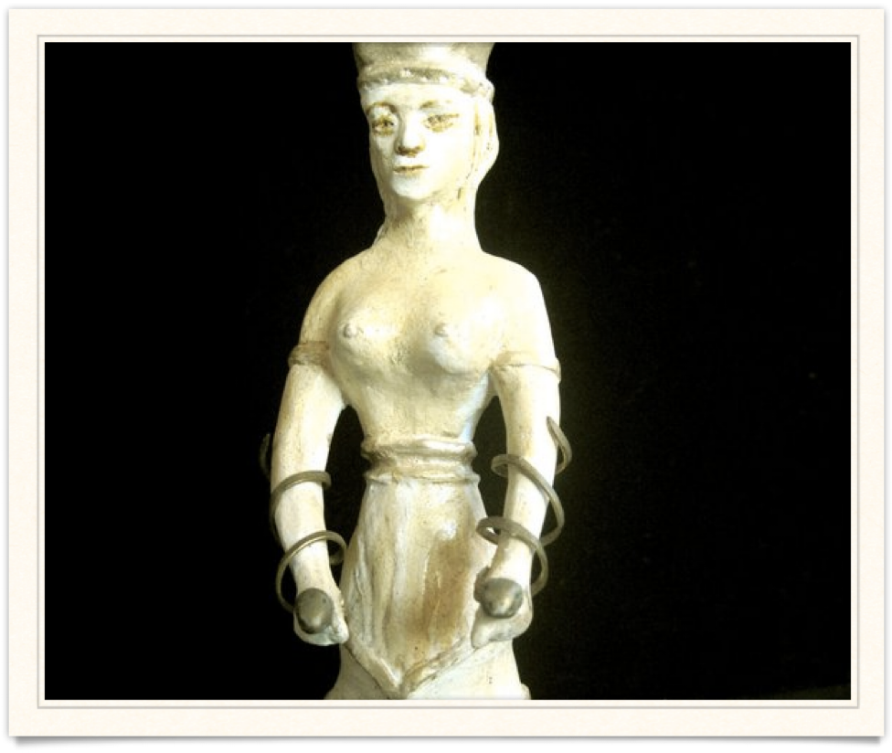
3. Snakes
Minoan snake goddess figurine

Slide 24
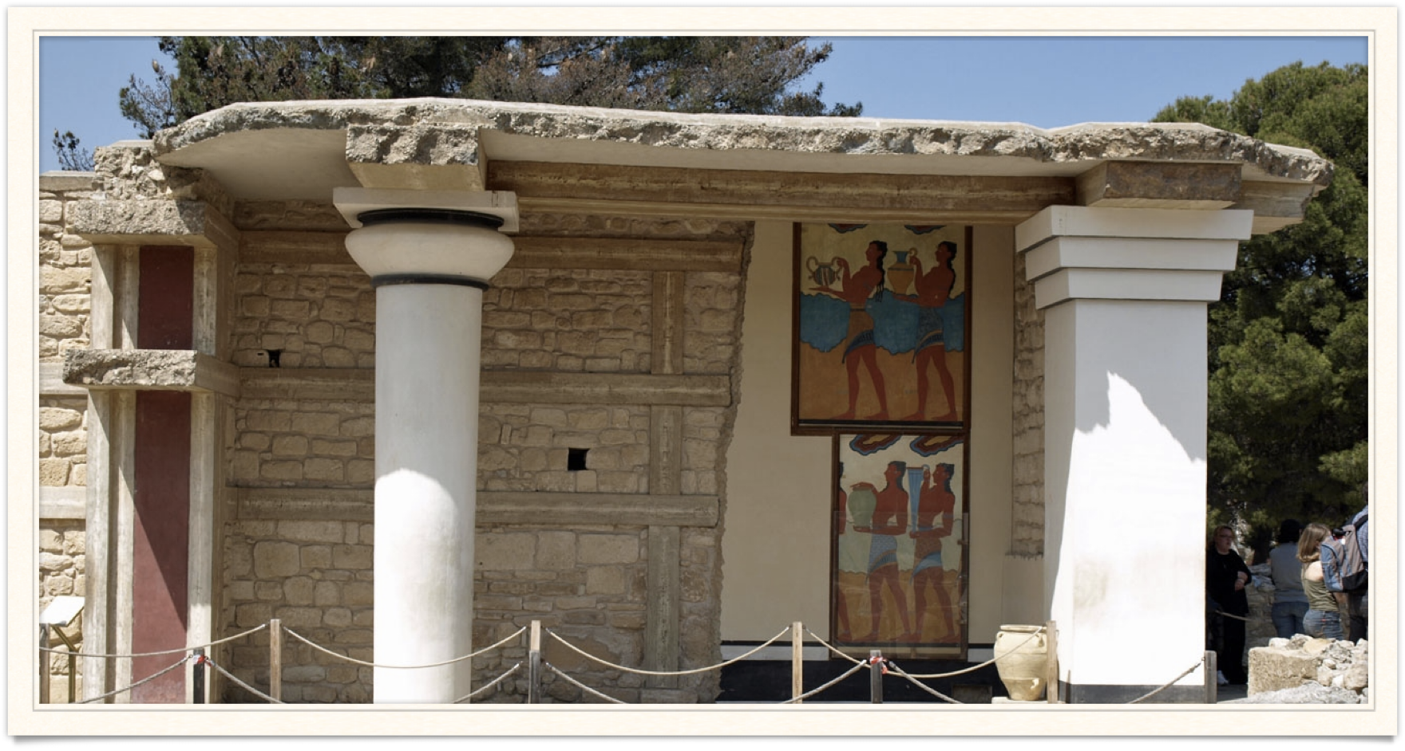
4. Pillars/Columns
Crypt at Palace of Knossos

Slide 25
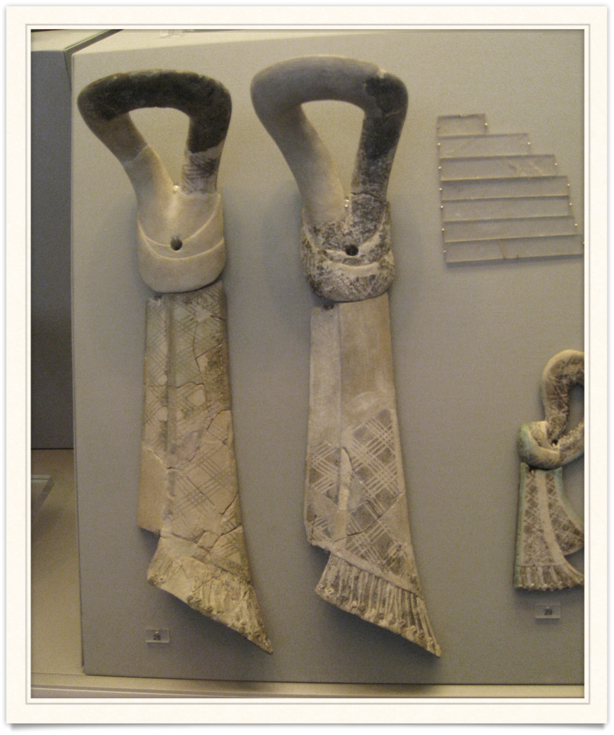
5. Sacral Knots

Slide 26
Religious Practices
Goddess epiphanies: At the throne room of a palace, a priestess would receive offerings as the epiphany of the Great Goddess
Human Sacrifice: only at times catastrophe
Animal Sacrifice: bull, officiated by pressed, and drained blood
Votive Offerings: objects in sacred place with vow/promise to God
Feasts/Dances: artefacts of cups, dishes, and sacred dancing (frescoes)
Processions: Raised walkways, on frescoes: celebratory (eg.g harvest)
Libations: poured on ground as offerings

Slide 27
Activity – Pair Reading Comprehension
In pairs, read through the information sheet.
Answer the following questions in your book:
Identify the ‘Religious places’ and describe each in 3 words
Define and describe ‘inhumation’
Explain the process of sacrifices
Identify and briefly describe the different types of burial and tombs

